Slide 1
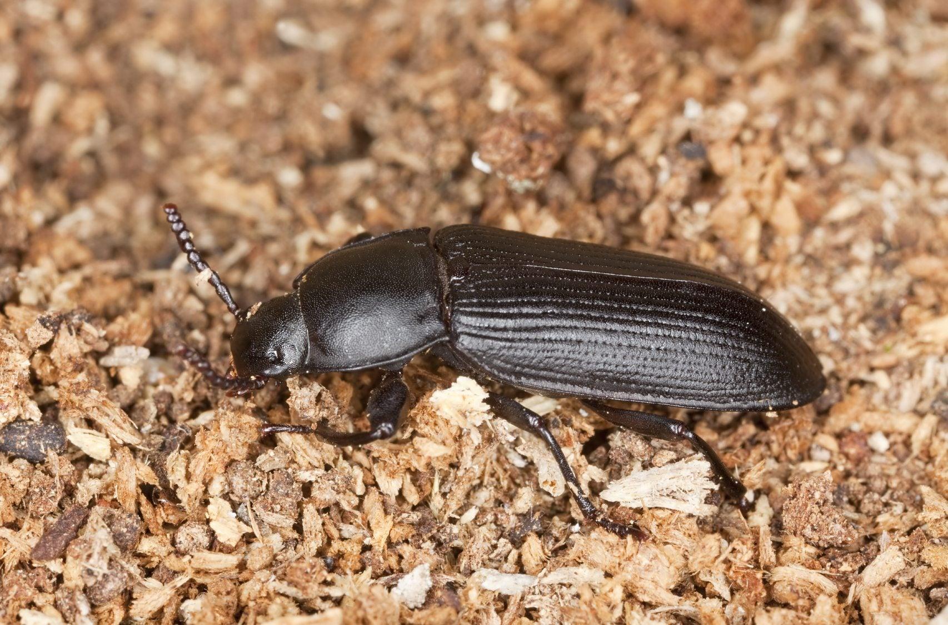

Darkling Beetle
ENRICHMENT DESIGN
Jadyn Goodson-Pelayo
Bryce Dodson
Brandon Ho
Pablo Vasquez
Spring 2026 / Oklahoma City Zoo/ Engineering 1413

Slide 2
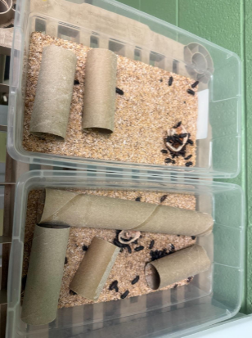
WHY THIS MATTERS
Client
OKC Zoo Information
Oklahoma City Zoo
100 colonies - 57 mealworm bins
68-72 F - 50% humidity
Current hides: cardboard tubes and egg cartons
Problem Statement
Research
The Oklahoma City Zoo needs enrichment structures for Darkling Beetles.
Habitats- under rocks, logs, in fungi, etc.
Nocturnal
Like to burrow

Slide 3
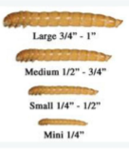
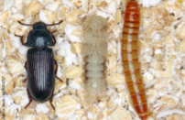
REQUIREMENTS, CONSTRAINTS, & DESIGN CRITERIA
1
Requirements
2
Constraints
8-10" long (small bins)
12-15" long (large bins)
4" wide MAX
3-4" tall MAX
Textured grip surface
Ventilation holes
Multiple entry/exit
No wood
Acrylic/sturdy plastic
Non-toxic material
No stain/paint/etc.
Smooth edges
$50 budget
No small pieces
3
Design Criteria
Cleanability (30%)
Size/Space (40%)
Natural Look (20%)
Elevation (10%)

Slide 4
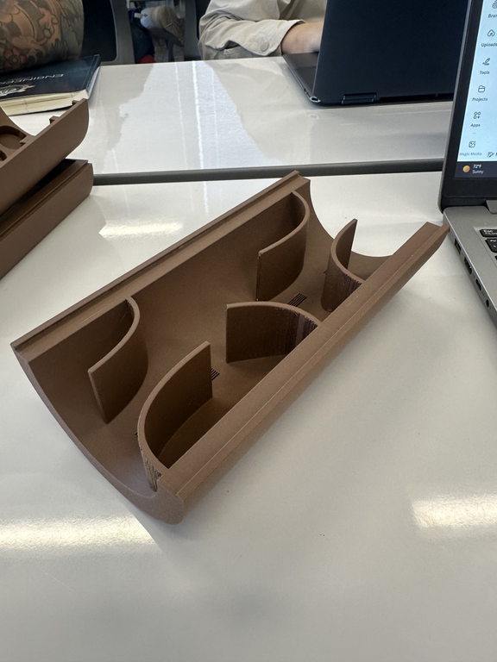
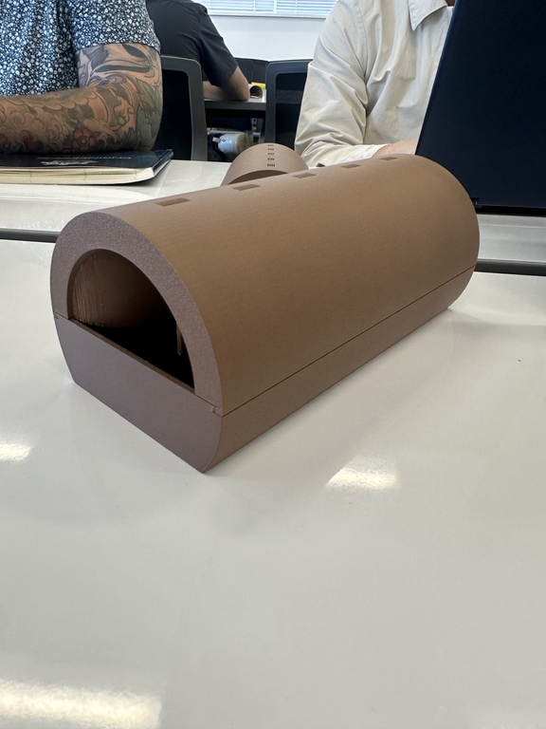
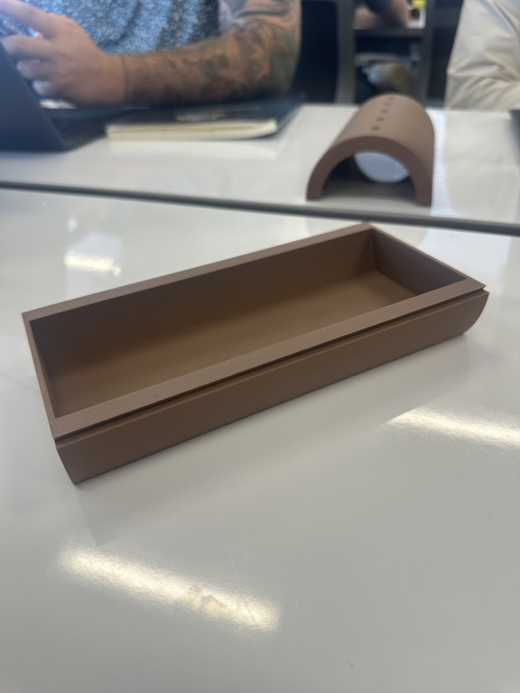
FIRST PROTOTYPE
3-D PRINTED
ClLIENT FEEDBACK
Two-piece slide connection​
8" long, 4" diameter​
Half-cylinder log shape​
Internal dark chambers​
Ventilation slits (top)​
Multiple entry/exit holes
Add texture on bottom piece
Add vent holes on bottom piece
Thinner design if possible
Make sliding easier

Slide 5
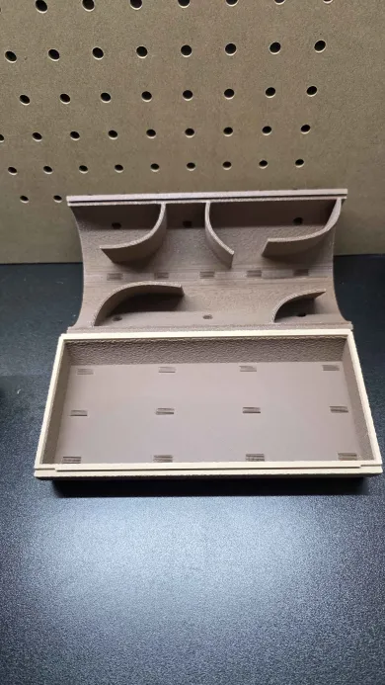
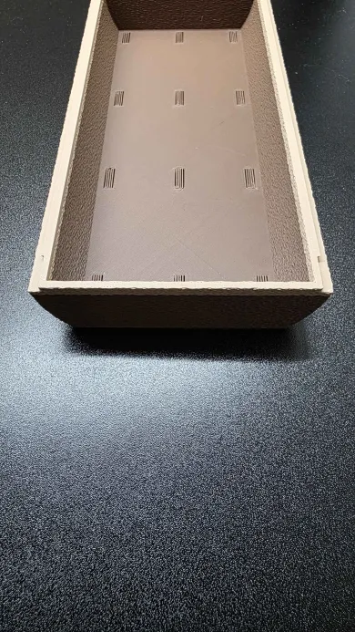
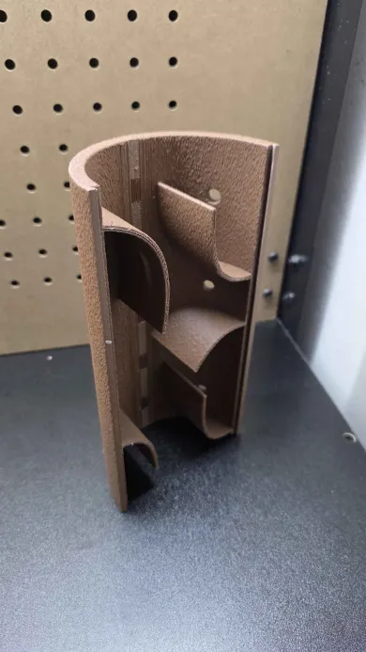
DESIGN CHANGES
1
Fuzzy Texture
2
Vent Holes
Added texture on inside and outside of bottom piece.
Added vent holes on bottom piece floor.
3
Alignment
4
Thinner Design
Added alignment grooves to help with sliding.
Made design thinner & cheaper

Slide 6
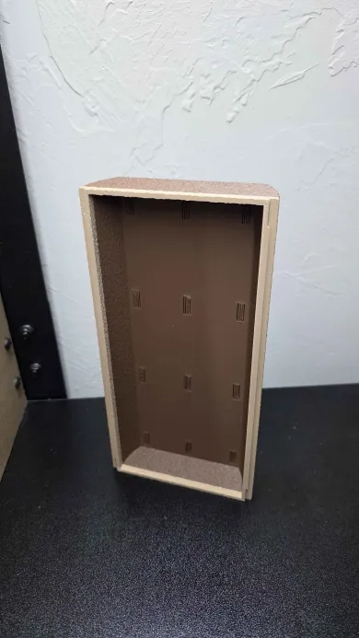
FINAL DESIGN
3D printed — Brown PLA​
Fuzzy skin texture​
8" long × 4" diameter​
Two-piece slide connection​
Internal dark chambers​
Ventilation slits (top)​
Multiple entrances/exits​
1.5" buried in substrate​
Fits small & large bins​
Washable — no hardware​

Slide 7
TESTING & RESULTS
Requirement
Test Method
Pass Criteria
Prototype
Final
Measure/check LWH
Length < 11"
Dia. < 5"
Size
PASS
PASS
Get dirty and attempt to wash
Pieces slide apart easily
Cleanable
PASS
PASS
Place bugs; observe climbing
Bugs grip and climb easy
Texture
FAIL
PASS
Place bugs; observe climbing
Bugs climb to different heights
Elevation
FAIL
PASS
Smoke exits vent holes
Ventilation
Dry ice fog test
PASS
PASS
Does not break when dropped
Strength
Drop test
PASS
PASS

Slide 8
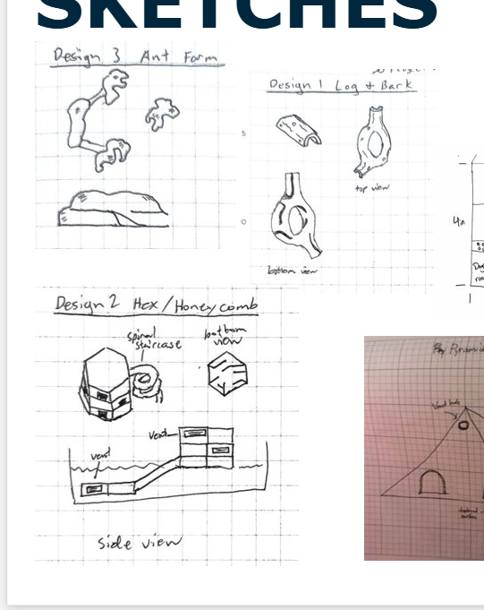
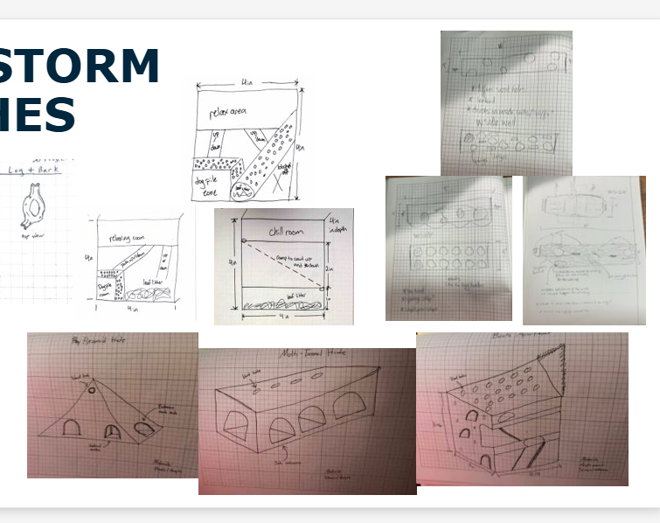
CONCLUSION
KEY TAKEAWAYS
All 6 requirements passed (final design)​
$5 total cost — 90% under budget​
Client approved design at review​
Fuzzy skin solved texture & elevation failures​
Reusable, washable — replaces cardboard​
IF MORE TIME/BUDGET
Test additional texture patterns​
Refine internal tunnels for burrowing​
Produce multiple sizes for all bins​

